Slide 1
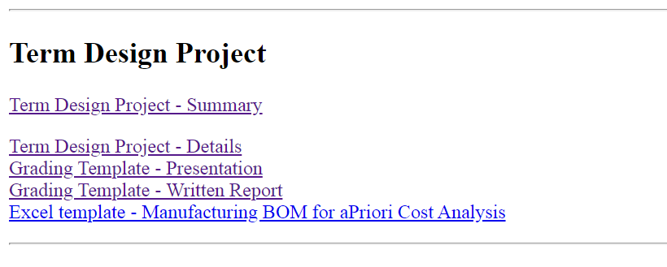
Lecture Class Slide Presentation 4-9-2020
Today we will complete a rather complex assignment on “worst case tolerance” calculations for a model car assembly. This has both custom designed and off-the-shelf components, as is commonly the case. For your projects, I ask you to perform a similar analysis on an assembly of your own parts focusing on both radial and axial fits of the moving parts of your design. Typically moving parts have some sort of bearing arrangement with the axis down the center of hinge pins or shafts driving the type of fit. Fits for moving parts are generally clearance fits, however, if we use a ball bearing we may need to press fit or push fit the inner and outer races of the bearing onto the shaft and housing as in Lecture Class Assignment #12; the inner row of balls provide the motion and associated clearance fits built into the device. In this case, however, we use plain bearings that must have sufficient clearance in both radial and axial directions to provide smooth, low-friction motion.
The remainder of the slides review the “Engineering Drawing – B” notes posted on the class website
FYI: I have added to the website the following documents providing important requirements for your “Term Design Project” presentations and reports. Please review in your teams and let me know if you have any questions or concerns.
And don’t forget to complete the Lecture Class assignment within the next 3 days for full credit – you can type within powerpoint, or print on paper then either scan it or take a picture with your smart phone

Slide 2
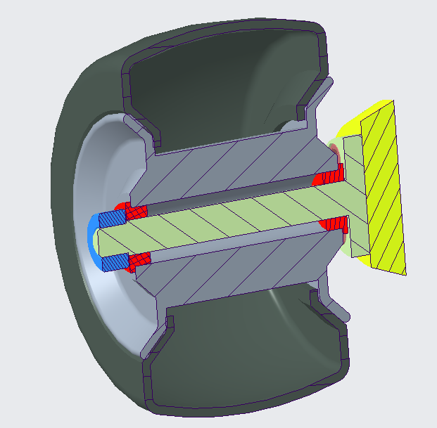
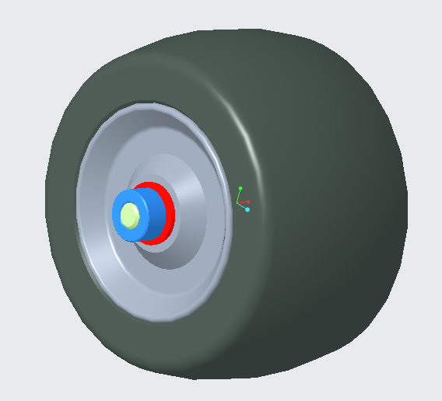
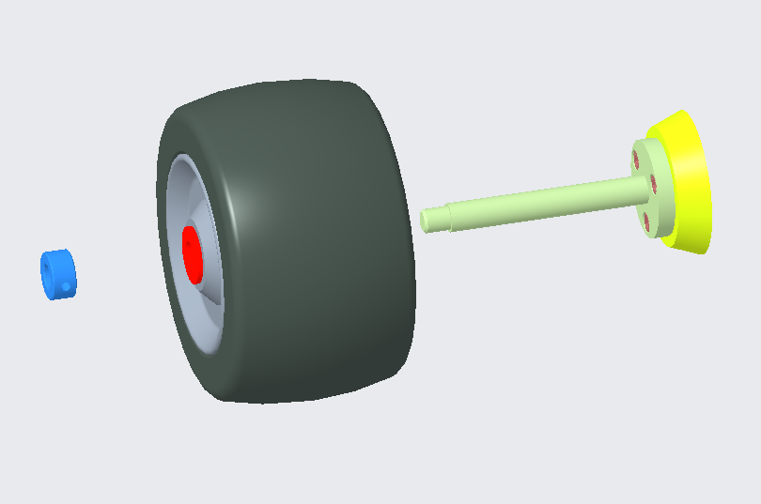
In this assignment, we use an off-the-shelf solid bushing (aka: plain bearing) purchased from a catalog and incorporate them into the design of a model radio-controlled racing car.
I have taken a few screen shots of the Creo assembly, to the right. The wheel sub-assembly comprises the wheel, the two bushings (red parts), and the tire. This sub-assembly, slides onto the shaft and is held in place by the (blue) collar with a set screw. The blue collar is pushed up against the step in the shaft before being tightened in place with the set screw (not shown).
I also saved the Creo assembly file as a 3D pdf so, if you like, you can open this link and explore in a little more detail:
3D RC car pdf
Ps. In Creo, you can “Save As” and select “PDF 3UD” to allow others without a CAD system to be able to pan, spin, zoom, x-section etc using a regular pdf viewer.
Tire
Solid Bearings
Shaft
Collar
Exploded Main Assembly

Slide 3
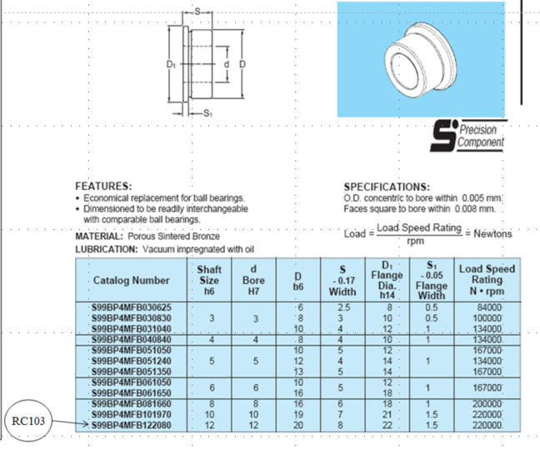
This is a catalog page from SDP/SI Precision Components (https://sdp-si.com/)
This sintered bronze plain bearing is used to provide a simple low cost, reasonably low friction design solution to support the wheel on the shaft and allow free rotation.
Notice the catalog tells us what tolerance too put on the mating shaft (h6) and what tolerance their bearing has (d bore H7). It also gives tolerances of the various thicknesses of the flange and bearing that control axial clearance.
The part we are using is the 12mm ID, 20mm OD bearing in the red box. The flange dimension S1 is 1.5 mm and the tolerance is written as “S1 -0.05”. when there is only one limit specified in a catalog the assumption is that the other limit is 0. so read this as: 1.5 +0.00/-0.05

Slide 4
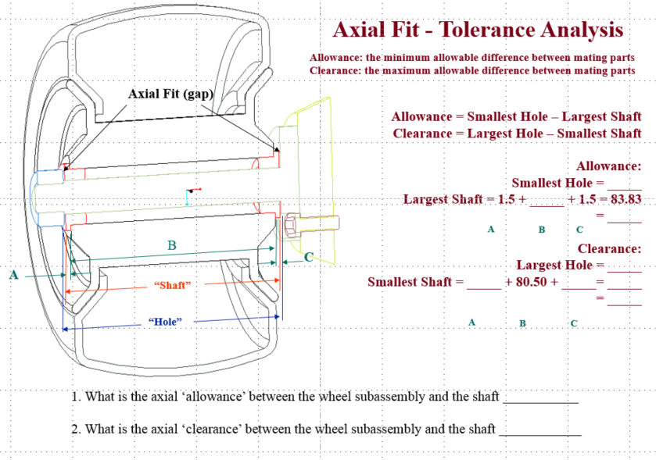
The wheel subassembly must have both radial and axial clearance if it is to freely rotate. The focus of this assignment is the axial clearance i.e. the clearance in the direction of the axis of the shaft. Referred to as the “Axial Fit (gap)” in the diagram.
As in the previous assignment, we calculate the worst-case assuming that each part is at its smallest and then largest. If we end up with a negative number then we have interference, and this we must avoid if the wheel is to freely rotate under all legitimate manufactured/actual dimensions.
Fill in this page of the assignment showing your calculations in the red area and then filling in the final answer at the bottom under 1. and 2.

Slide 5
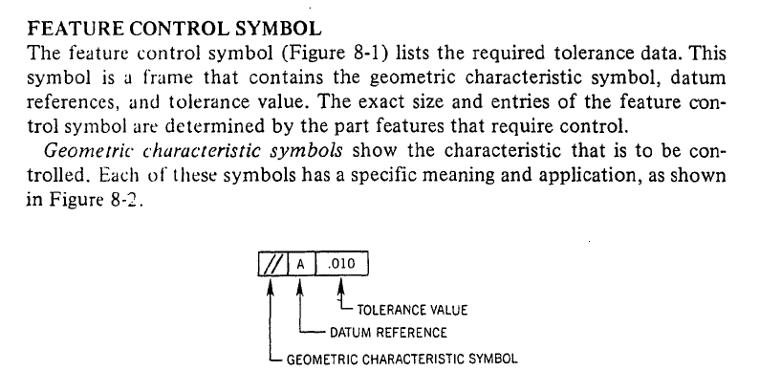
Remainder of the slides are excerpts from
ENGINEERING DRAWING NOTES B – GD&T
As I mentioned previously, you need to understand GD&T concepts as many companies, particularly large internationals, have adopted this standard. However, for your projects, I do not require it, but feel free to add some appropriate geometry symbols if you think it’s required or would help.
The first set of geometries (next 2 slides) require no Datum Reference as they are defined by themselves.
The remainder require one or more reference, usual one or more datum planes.
There are more details given the pdf set of notes on the class website. These slides give a condensed summary version.
The Feature Control Symbol is the label identifying the tolerance being requested, by the designer, of the manufacturer.

Slide 6
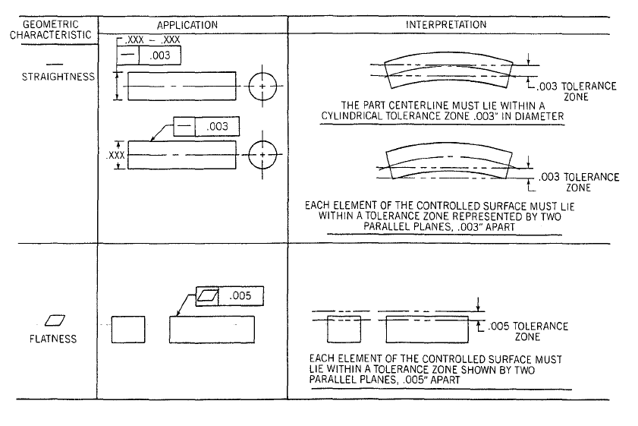
No datum reference, just a tolerance zone

Slide 7
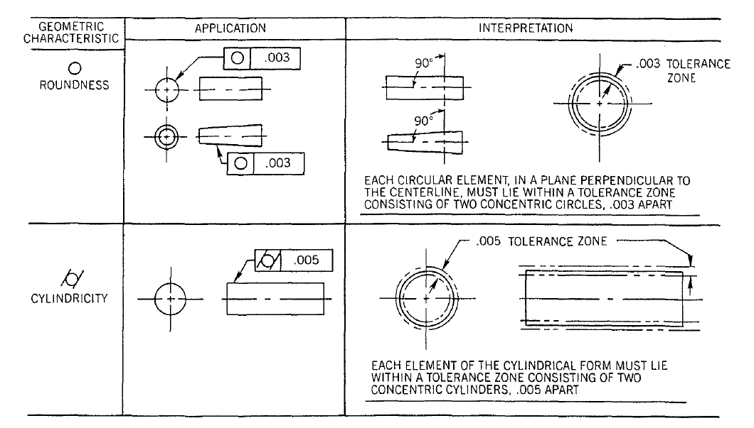
Again, no datum reference, just a tolerance zone.
Roundness measuring machines have stylus mounted to a rotating table. The position date from the stylus is fed to a micro-computer; “Roundness” error and/or “Cylindricity” error are displayed on the screen.

Slide 9
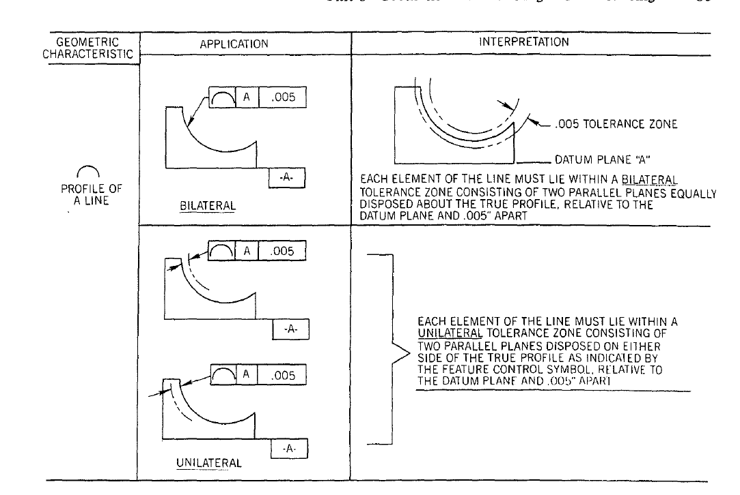
Requires a datum reference; at least one. In this case -A-
Which must be identified on the drawing along with the feature control symbol.

Slide 10
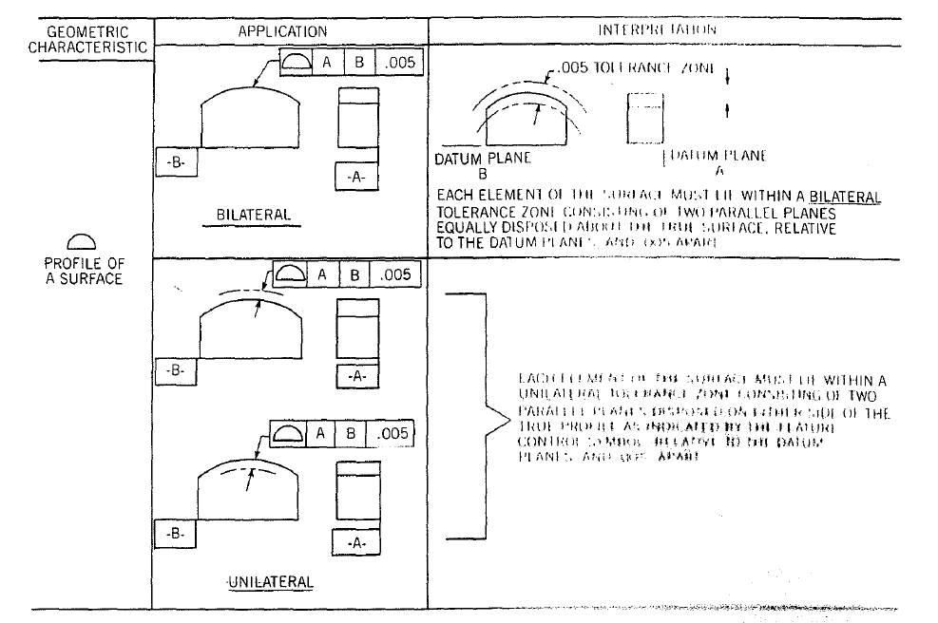
Requires a minimum of 2 datum references; In this case -A- and -B-
Both must be identified on the drawing along with the feature control symbol.
This is used a lot to check mold surface profiles. Usually using CMMs (Coordinate Measuring Machines)

Slide 11
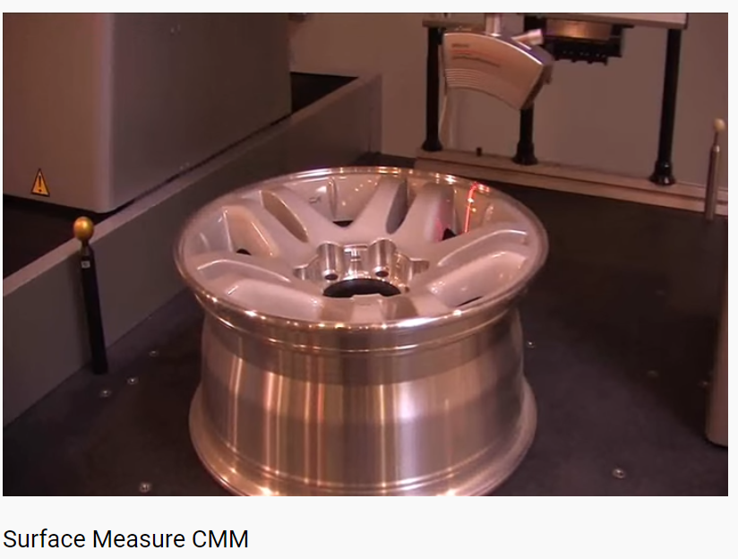
Scanning the profile of the surface using a laser probe.

Slide 12
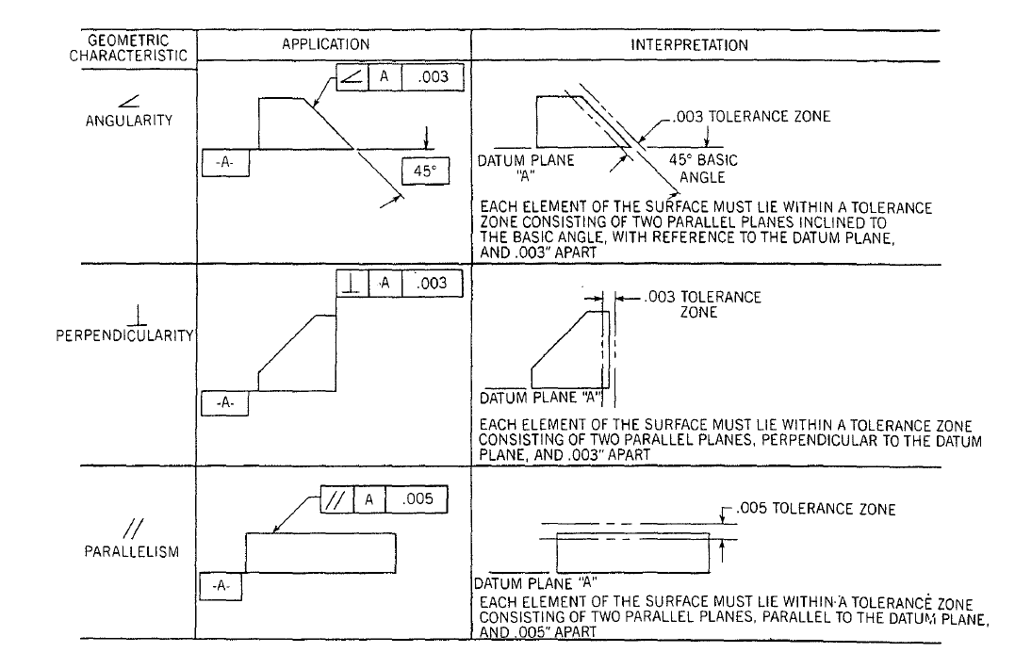
Requires a datum reference; at least one. In this case -A-
The datum is the other surface forming the angle, or perpendicular, or parallel condition. Again, it must be identified on the drawing along with the feature control symbol.

Slide 13
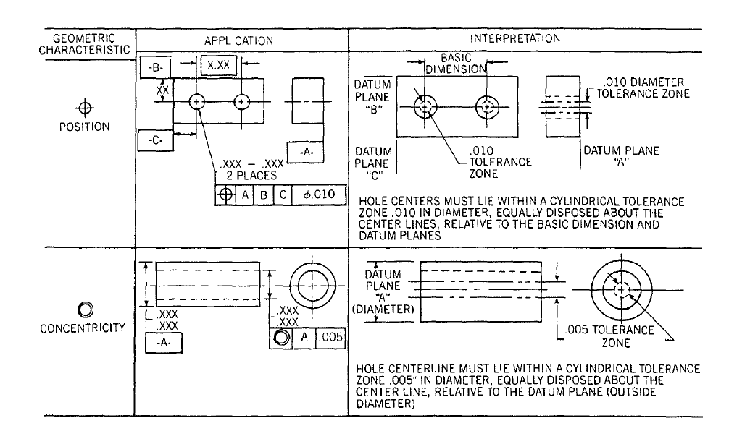
Position tolerance is the most popular and most widely used GD&T methodology. Its very powerful as it allows you to control the location and size of holes with a “Basic Dimension” and a Diametral tolerance zone in all three planes in space.

Slide 14
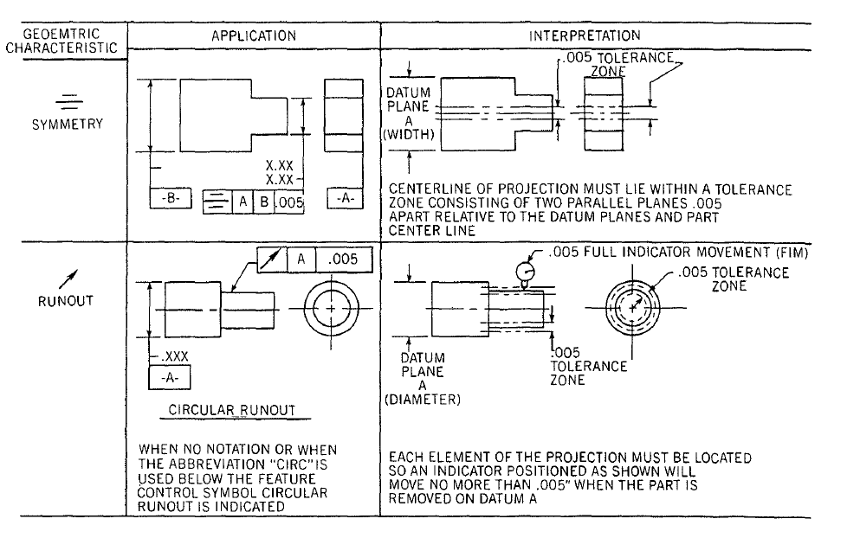
Runout uses a dial gauge and is commonly used for rotating shafts to check that they will rotate without wobble or off-center rotation causing imbalance and potentially unacceptable vibrations at high speed.

Slide 15
